Slide 1
Welcome to Code.Sip.Repeat 3.0

Slide 2
Agenda

Slide 3
Welcome from host
Jason Bradshaw, Code.Sip.Repeat

Slide 4


Introduction of Instructor
Mr. Richard Richardson

Slide 5
Interactive Scoreboard
By Richard Richardson

Slide 6
Agenda
Getting Started the Anaconda Environment
Systems Engineering Overview
Review Object Oriented Programming Principles
Build the data types
Import the data
Output the data

Slide 7
System Engineering Overview
Most systems are data centric
Data In
Manipulate Data
Data Out
System
Data In
Data Out

Slide 8
System Engineering Overview
Steps to building a system
Define the data the system will operate on
Define where the data will come from
Define what the system will do with the data
Define where the data goes
Data Storage
System
Display
Data Storage

Slide 9
Object Oriented Programming
Object-oriented programming is a programming paradigm, or classification, that organizes a group of data attributes with functions or methods into a unit, known as an object
Typically, OOP languages are class-based, meaning a class defines the data attributes and functions as a blueprint for creating objects
Class: A class is a data type that provides a framework for creating objects
Use to define common characteristics among many elements
A Human has a name, birthdate, social security number, birthplace, etc
Object: In OOP, an object represents an instance, or creation, of a class
Inherits the common characteristics defined by the class
Richard is a human and therefore has all of the common characteristics
Defines Richards specific characteristics

Slide 10
SE101 – Object Oriented Programming
Object-oriented programming is a programming paradigm, or classification, that organizes a group of data attributes with functions or methods into a unit, known as an object
Typically, OOP languages are class-based, meaning a class defines the data attributes and functions as a blueprint for creating objects
Method: A method is a function that performs a task or action
Update Richards Age, etc
Attribute: This structure stores information about an object and defines its state
Richard is 51
Richards birthplace is Dayton, Ohio

Slide 11
Build the Data Types
Scoreboard
Game 1
Game 2
Game 3
Team 1
Team 1
Team 2
Team 2

Slide 12
Break and Sponsor Presentation
Botts Innovative Research

Slide 13
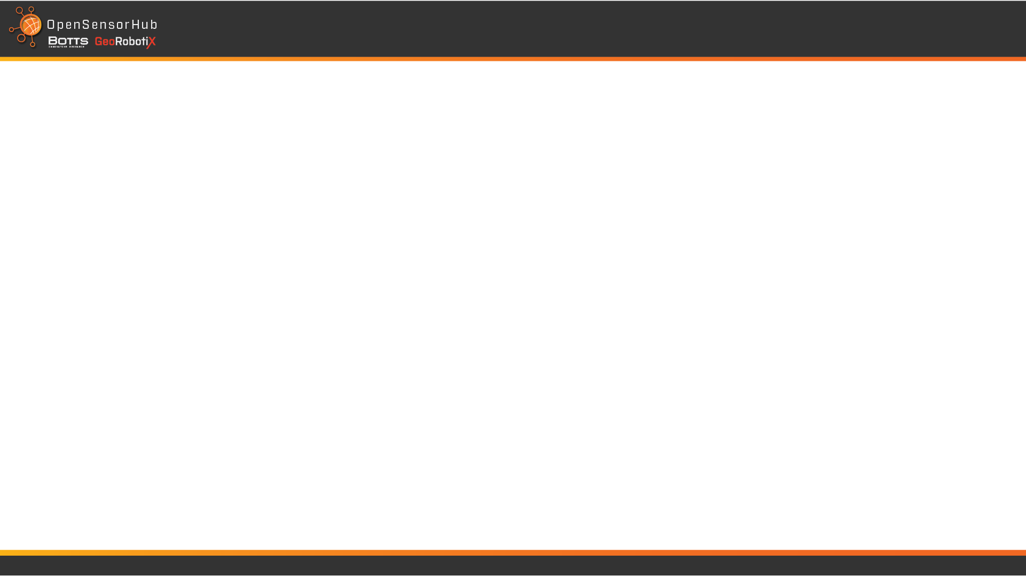
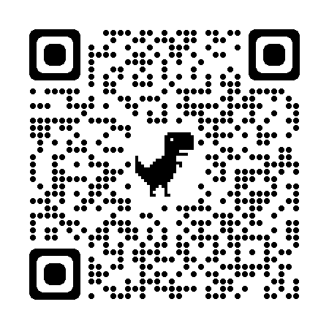
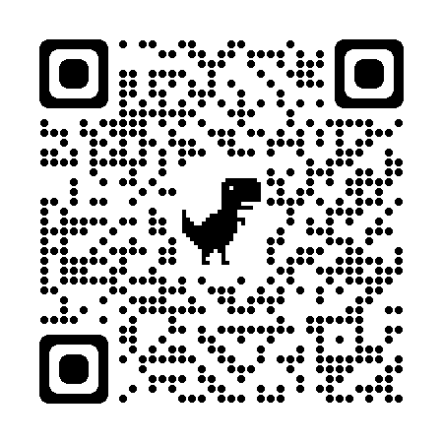
Intro to OpenSensorHub
Dr. Mike Botts
Code.Sip.Repeat
Dec 2023
Discord
OpenSensorHub.org

Slide 14
What is OSH and what can it do for me?
U N C L A S S I F I E D
Open source, open standard software platform
Provides a common language for “speaking” with sensors, processes, and actuators (“discover, sense, think, act”)
Provides helpers:
Core OSH (storing and streaming of data in JSON, CSV, XML, or binary)
Sensor drivers (in Java or Python)
Visually display data in Dashboards, COPs, charts (Javascript

Slide 15
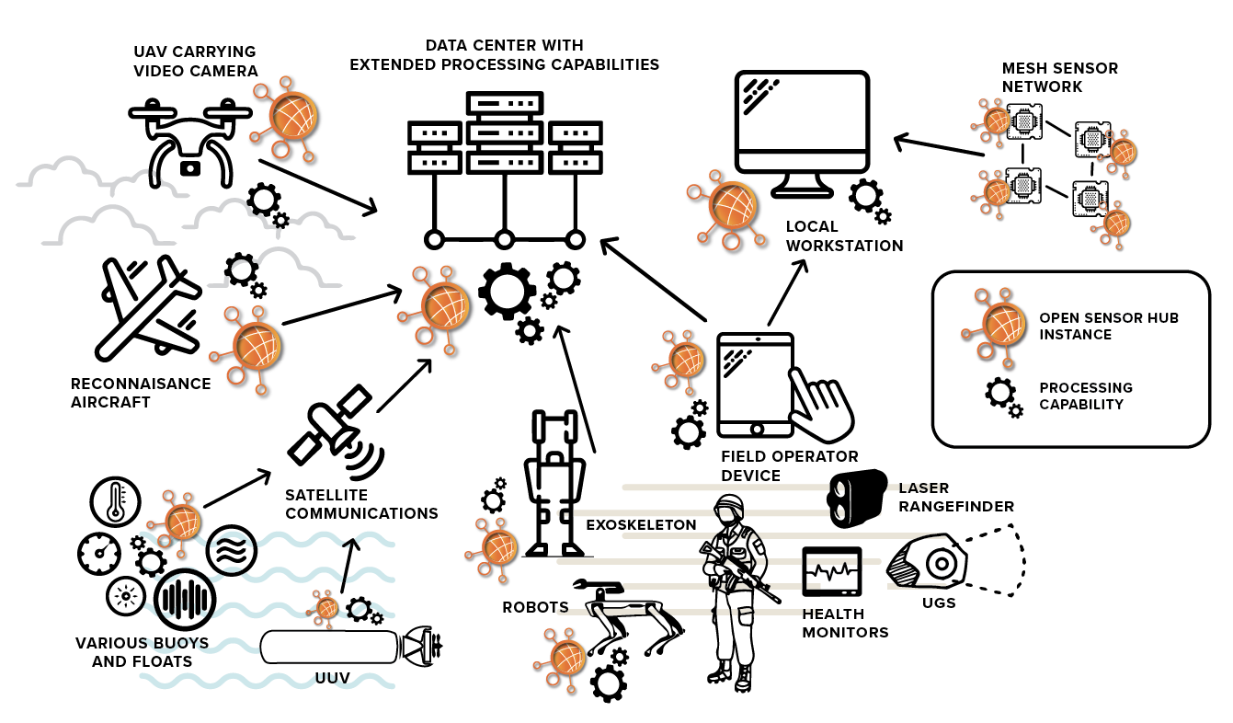
U N C L A S S I F I E D

Slide 16
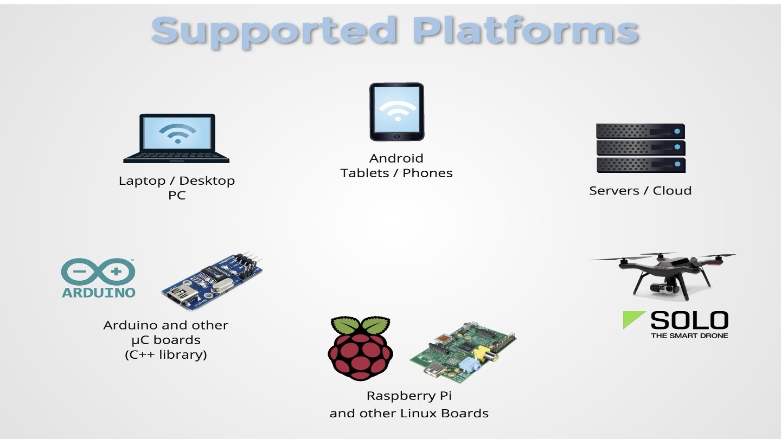
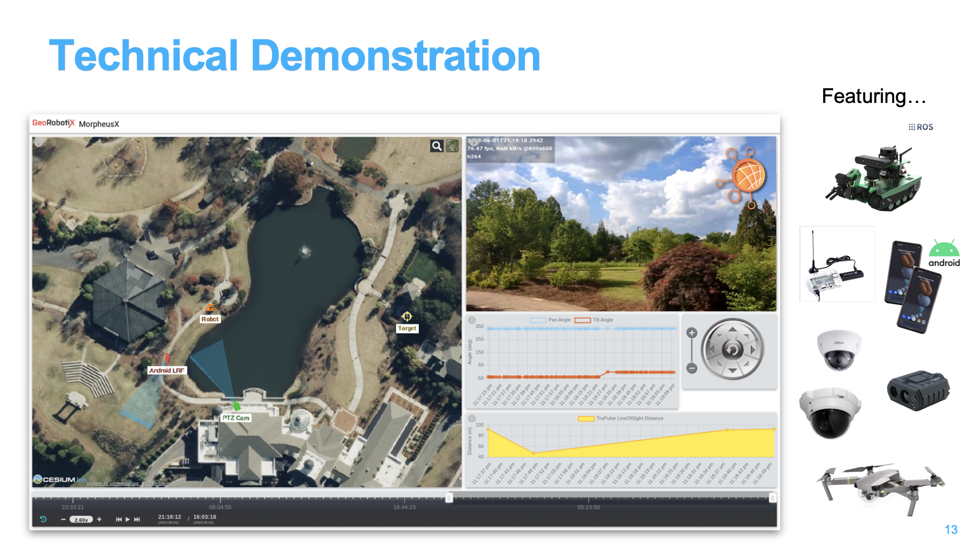
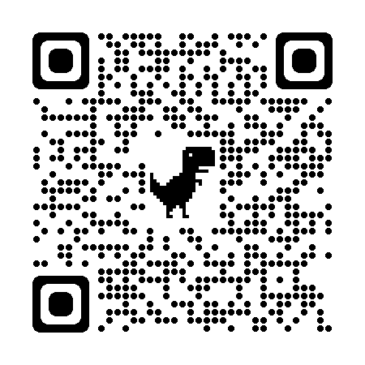

Slide 17
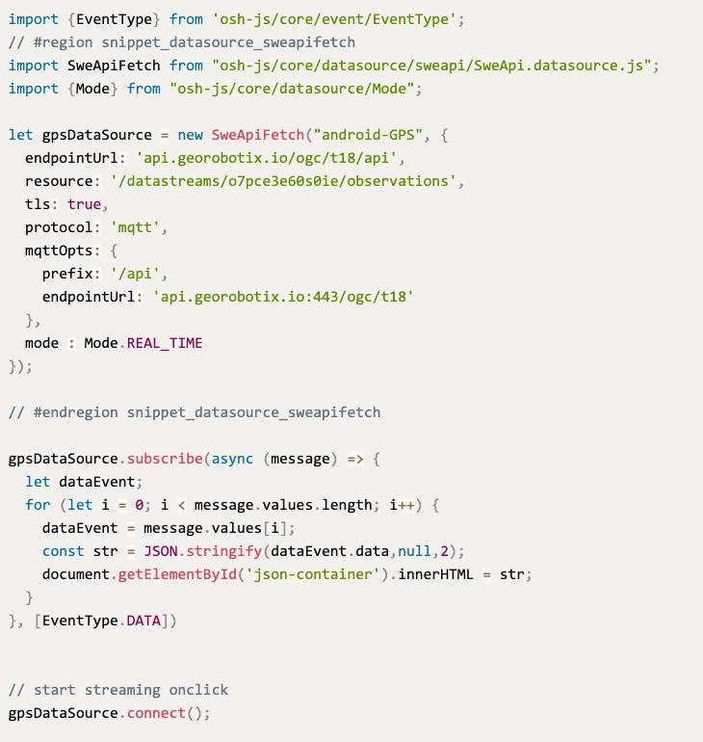

Examples and Showcases
Data Retrieval from OSH
Location and Track Dashboard
Showcases:
Data Retrieval
Dashboard

Slide 18
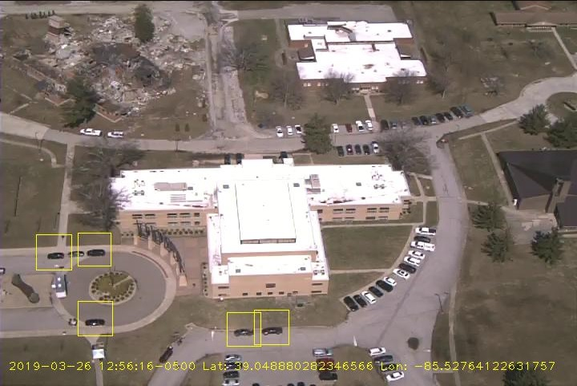
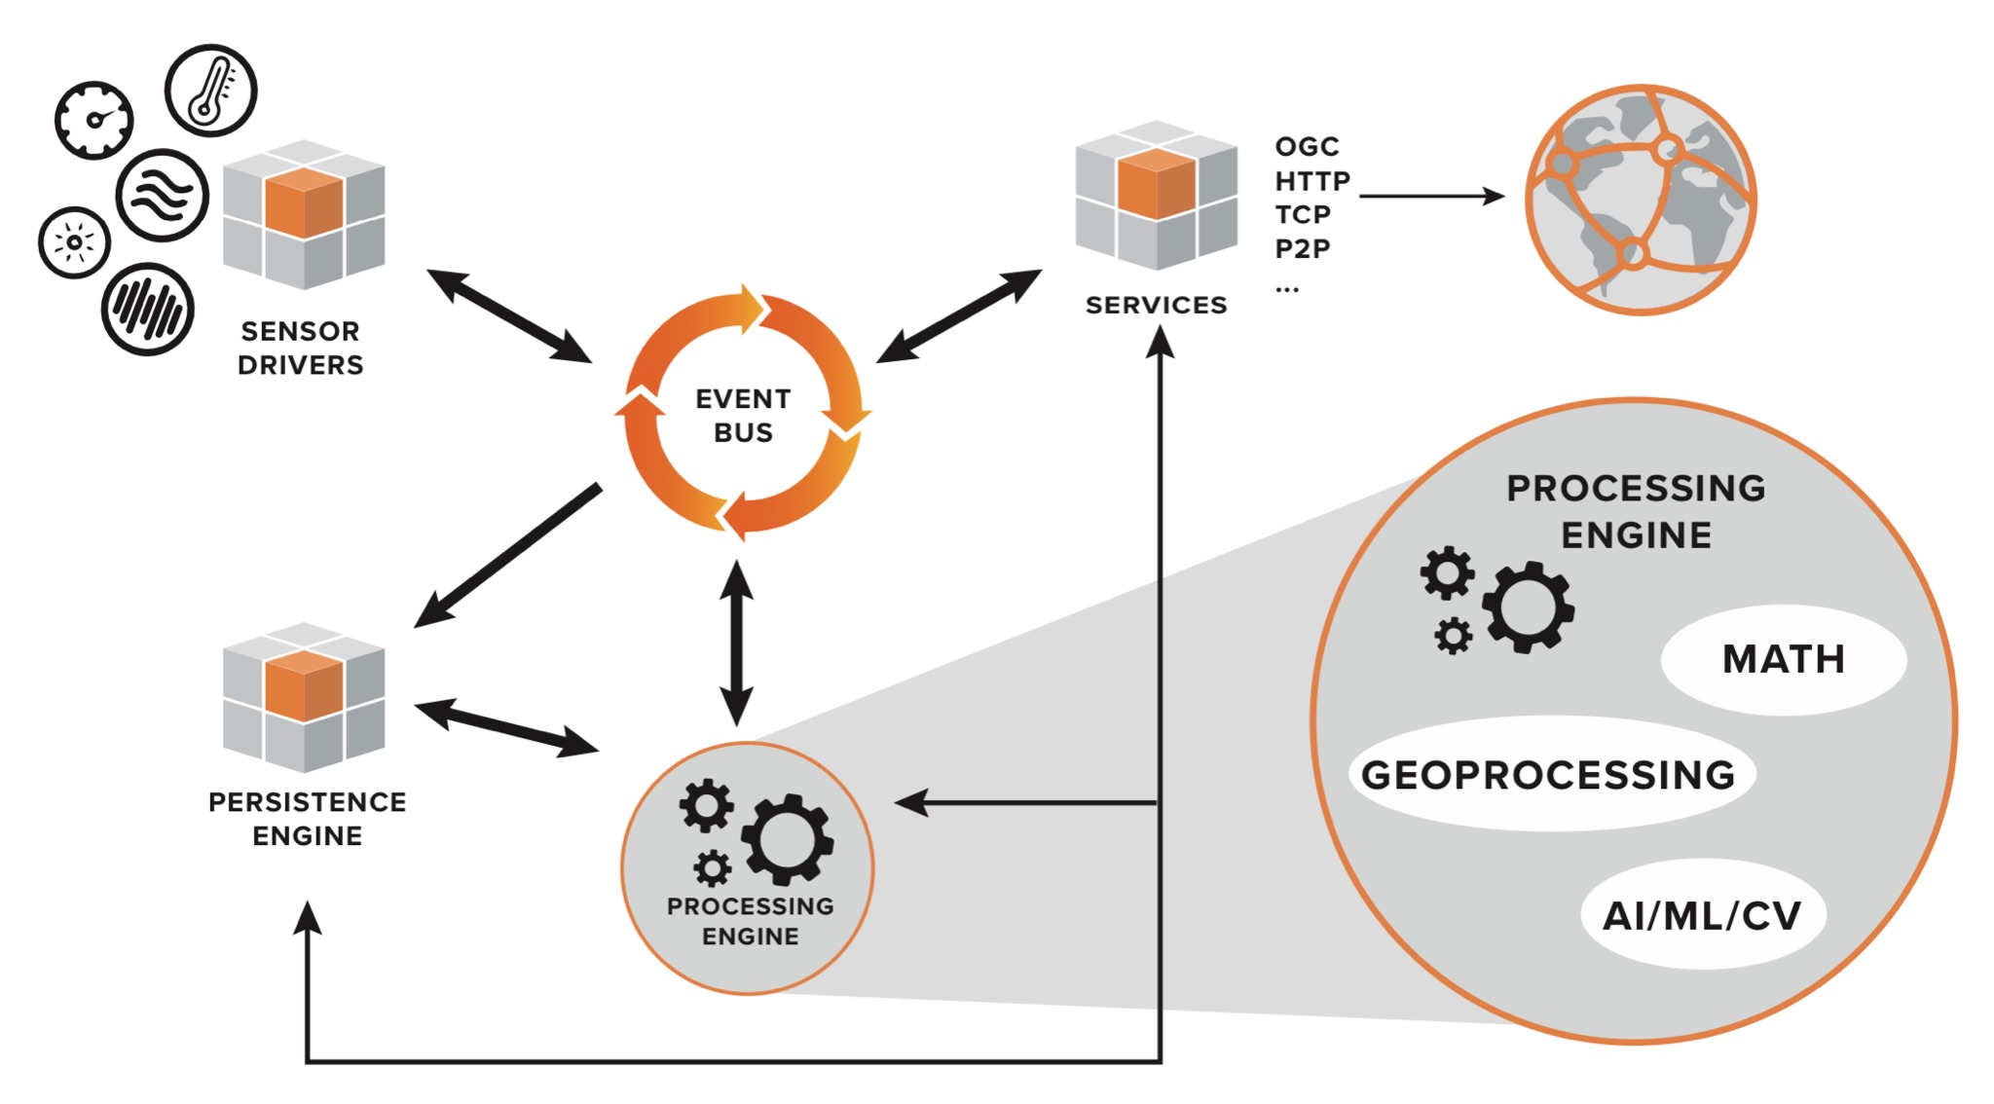
AI/ML/CV Integration using OSH
U N C L A S S I F I E D
Processing can be managed from within any OSH node, and distributed across many nodes
Processing provided by libraries or “black-box” code can ingest input data from an OSH node and feed output into OSH nodes for management and standard access
Simple OpenCV computer vision model managed by OSH, used to recognize automobiles. Output could be reduced to DDIL-friendly geospatial locations.

Slide 19
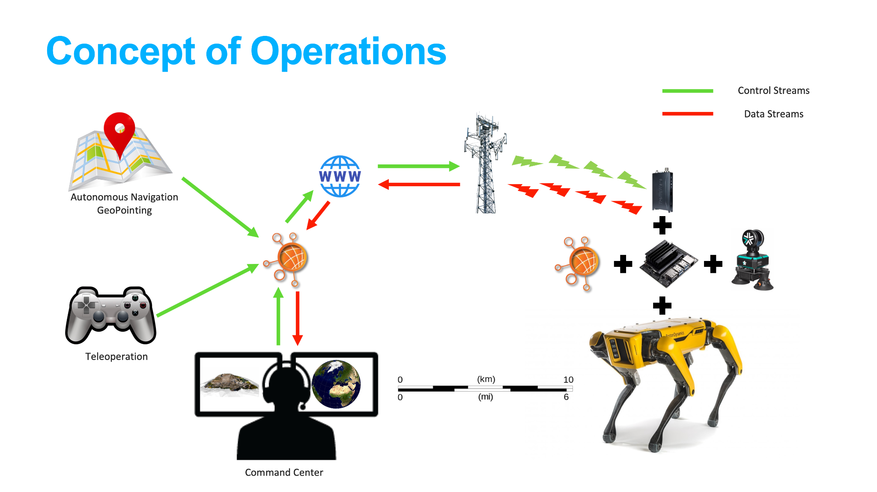
AI/ML/CV Integration using OSH
U N C L A S S I F I E D
Processing can be managed from within any OSH node, and distributed across many nodes
Processing provided by libraries or “black-box” code can ingest input data from an OSH node and feed output into OSH nodes for management and standard access
Simple OpenCV computer vision model managed by OSH, used to recognize automobiles. Output could be reduced to DDIL-friendly geospatial locations.

Slide 20

Checkout additional public videos:
https://www.youtube.com/c/OpenSensorHubOrg2015/videos
Checkout the live recording of Connected-Systems:

Slide 21

We are looking for Java and Javascript developers
positions: https://botts-inc.com/jobs/
response: work@botts-inc.com

Slide 22
Any questions or comments?
mike.botts@botts-inc.com
(256) 652-0165

Slide 23
Build the Data
Define the Data Types that will be used

Slide 24
Data Type - Team
#This datatype defines all of the data associated with a team
class team:
def __init__(self, name, score):
self.name = name
self.score = score
Note:
The __init__ function is called every time an object is created from a class. The __init__ method lets the class initialize the object's attributes and serves no other purpose. It is only used within classes

Slide 25
Data Type - Game
#This datatype defines all the data required for a game
class game:
def __init__(self, name1, name2):
self.team1 = team(name1, 0)
self.team2 = team(name2, 0)
self.period = ""
self.time = ""
Note:
Each game can only have 2 teams

Slide 26
Data Type - Game
Let’s add some methods/functions to the game data type
#Method to update the score
def updateScore(self, score1, score2):
self.team1.score = score1
self.team2.score = score2
#Method to udate the time left in the game
def updateTime(self, period, time):
self.period = period
self.time = time
#Define a method to determine if 2 instances of this class object are equal
def __eq__(self, other):
if not isinstance(other, game):
return NotImplemented
#Returns true if the name of both teams are the same and false otherwise
return self.team1.name == other.team1.name and self.team2.name == other.team2.name
Note:
These methods are simple for the sake of time, but we could easily add some error checking to validate the input parameters.

Slide 27
Data Type - Scoreboard
class scoreboard:
def __init__(self):
self.games = []
Let’s add some methods to the scoreboard data type
#Add a new game to the scoreboard object
def addGame(self, match):
self.games.append(match)
#remove a game from the scoreboard
def removeGame(self, match):
self.games.remove(match)
#get the info for a particular game
def getGame(self, i):
return self.games[i]
#Delete all of the games in the list
def deleteGames(self):
self.games.clear()
#Update a game that is already in the list
def updateGame(self, match):
z = 0
for i in self.games:
if match == i:
self.games[z] = match
z += 1
#Check to see if the game is already in the list
def findGame(self, match):
for i in self.games:
if match == i:
return True
return False

Slide 28
Retrieve the Data
Build the method of populating the data objects

Slide 29
Output the Data
Build the scoreboard display where the data will be displayed

Slide 30
Break and Sponsor Presentation
BDPA Huntsville Chapter

Slide 31
BDPA Huntsville Chapter
https://www.bdpahsv.org

Slide 32
Closing Remarks and Survey

